Slide 1
World Bank Data Analysis
Team 8
Aradhna Sahni
Ayodeji Sobanke
Elizaveta Chaplygina
Kevin Castillo
Zhexin Gong
December 14, 2018

Slide 2
Context
Explored the data from the world bank for 2014
Focused on a region of 14 countries out of 217 countries in the world according to World Bank
Developed different strategies for imputing missing values
Described any outliers and correlations discovered during data exploration

Slide 3














What Countries did We Focus ON?

Slide 4
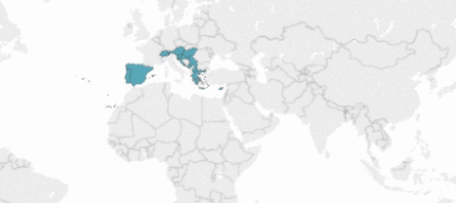

Slide 5
Descriptive Analysis –Well-being
Aspects that our region is outstanding from the world

Slide 6
Descriptive analysis – economy
Factors of our region that is not good comparing to income group and world

Slide 7
Positives Negatives
Austria: Labor market is powerful and is the 14 richest country in terms of GDP per capita .High Standard of living with well developed social market economy. Higher than average household income Within top 15 in Happiness Index
Switzerland: Rank 2 in Human Development Index . Peace-loving nation
Spain: Property sector caused banking crisis leads to strong economic downturn, a severe increase in unemployment, and bankruptcies of major companies
Also, corruption flourish shaky economy and rigid market
Macedonia: Suffered damages of around US$2 billion due to the trade embargo
Cyprus: EU debt crisis affected Cyprus

Slide 8
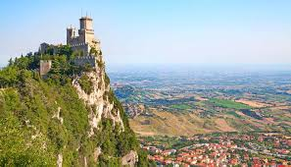
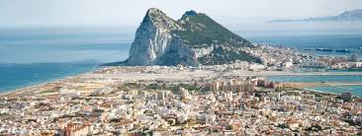
SAN MARINO
An enclave of Italy, a state within a state.
Sources of income: Tourism, Banking and Manufacturing & Exports
Population and Area: 33,779 & 61 sq km
Natural Hazards: Occasional earthquakes
GIBRALTAR
British Overseas Territory on the southern coast of Spain.
Self-governing in all matters except defense.
Sources of income: Offshore Banking, Extensive Shipping Trade,
International Conference Center and Gaming.
Population and Area: 29,461 & 6.5 sq km
Natural Hazards: Occasional droughts

Slide 9


Missing values SAN MARINO & GIBRALTAR
Both countries are classified as High Income, however most of their economic indices are missing.
INTENTIONAL NON-DISCLOSURE – WORLDBANK
Most high-income countries are not World Bank borrowers and thus not obligated to report figures on indices such as External debt, Aid data, Poverty data, Country’s Policy and Institutional, Assessment, Enterprise Surveys and Private Participation in Infrastructure.
SINCE THE DATA CANNOT BE TRUSTED HENCE THE EXCLUSION FROM WORLD BANK REPORTS - FITCH RATINGS
There has been a return to mild economic growth since San Marino's deep recession from 2009-2014, during which GDP contracted by a third. Final national accounts data is not yet available for 2016.
Over time there has been overvaluation of bank assets, particularly of San Marino real estate. State recapitalization of banks has been carried out which has also increased the public debt.

Slide 10





Missing Value Imputation Methods
Followed three methods for imputation
Out of 30 variables, imputing NA values for 16 variables by taking median of Greater Mediterranean Region.
2. Imputing NA values for Adult literacy and HIV with median of income group
Why?
One adult literacy value available only for Spain
Median of the whole world data provides low value
Shared sample characteristic with our region

Slide 11


Missing Value Imputation Methods
3. Imputing NA values for Agriculture employment and Tax Revenue with online data available from Central Intelligence Agency
Median of GMR
Online Data
Vs
Why?
Understanding the data for Gibraltar ,San Marino, Serbia and Montenegro
Chose the best possible representative value by comparing median with the CIA Data
Avoid disparity
Source: Central Intelligence Agency Database

Slide 12


Gdp in USD for Gibraltar
Finding a value that makes the most sense
Gibraltar’s Population: 34,038
Median GDP USD: $31,108,090,302
Following this: Gibraltar’s GDP per capita would be $913,922
World’s best reported GDP per capita: Liechtenstein - $179,308
More sensible method:
Average GDP per capita(region)
×
Gibraltar’s Population
=
$927,211,458

Slide 13
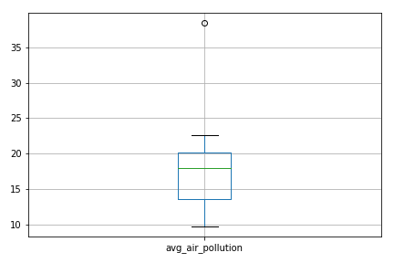
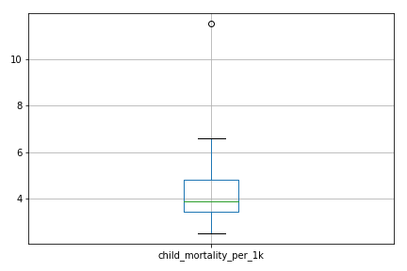
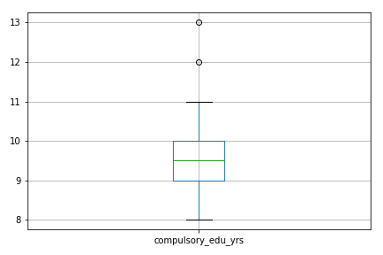

Outliers
One country stands out in outliers more than the others
Air Pollution
Child Mortality
Compulsory Ed Years
Macedonia

Slide 14
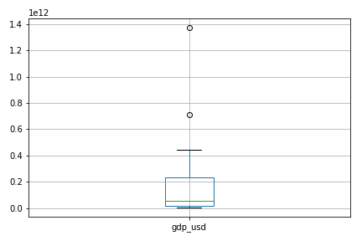
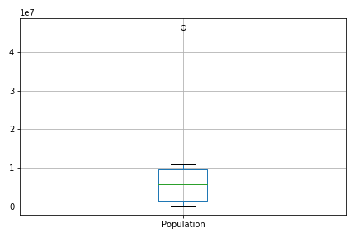
Outliers
Another country is an outlier in two important variables
GDP(in usd)
Population
Spain-The most Populated Country in our Region & country with highest gdp…….
Correlation?

Slide 15
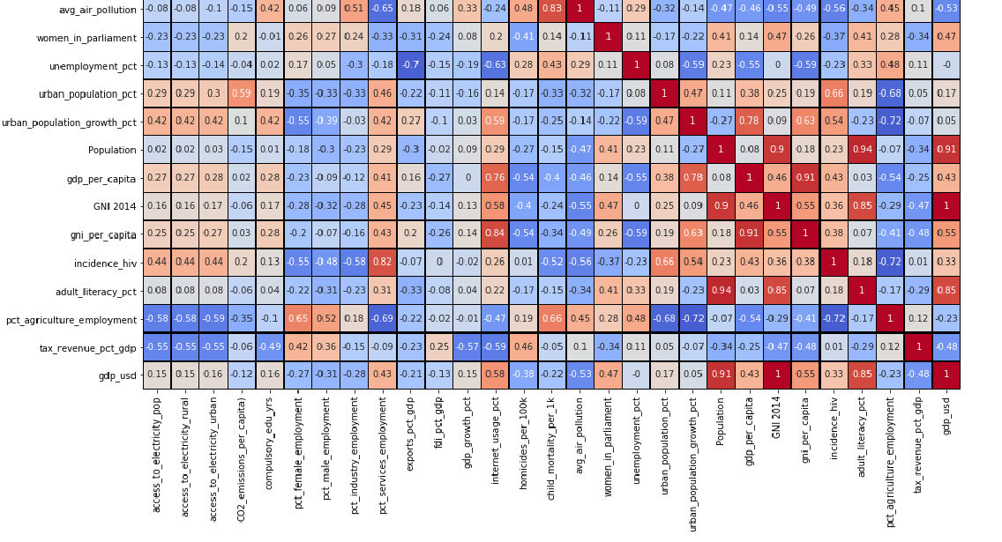
Exploring Correlations
Starting with GDP and Population
Heatmap shows that Population and GDP are strongly correlated with value of 0.91
Also helps confirm method of imputing Gibraltar’s GDP
Correlation between growth in urban population & GDP / capita: 0.78
Another finding: GDP / capita also strongly correlated with internet usage: 0.76

Slide 16
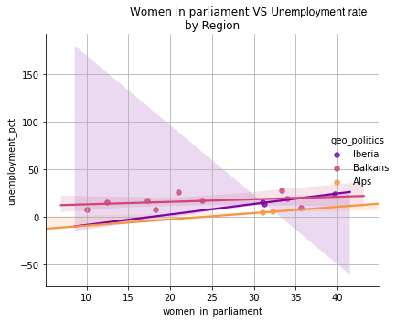

Be Careful
Correlation Causation
Too few data points
Not time series

Slide 17
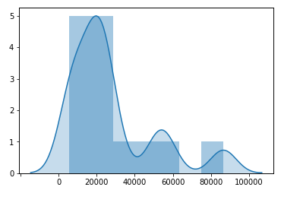
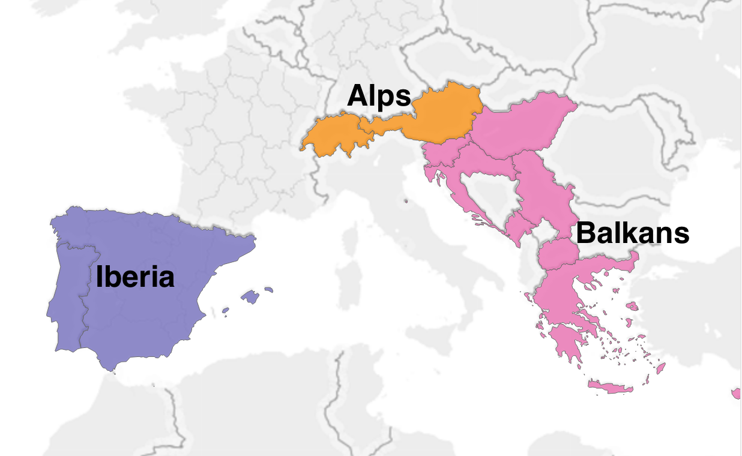
Notice regions
﻿﻿sns.distplot(data['gdp_per_capita'], kde=True, bins = 'fd’)
Geography
Politics
Economics
Distribution of
GDP per Capita
Balkans
Iberia
Alps

Slide 18
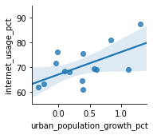
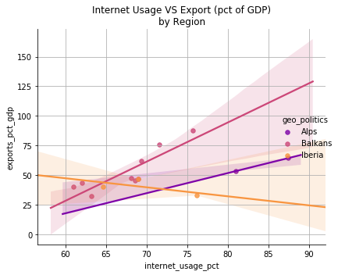

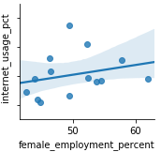
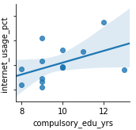
Economy drivers
👩🏼‍
🎓
Spain

Slide 19

Executive
Situation:
Required to analyze World Bank Data Set of overall 217 countries but focusing on Greater Mediterranean region with 14 countries. Many missing values mainly for Gibraltar and San Marino
Analysis & Outcome:
Developed missing values strategies with medians from region and income group. GDP was calculated with Population and average GDP per capita
Flagged outliers
Discovered some correlations

Slide 20
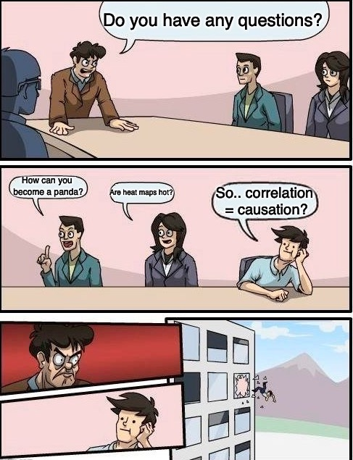
Q&A
THANK YOU!

